Slide 1

Sagar Ghimire
Computer Vision
Project: Gender detection using
features extracted from images

Slide 2
To-do lists:
Display Original Images for Male and Female
Display Original Gray Images and Histograms for Male and Female
Extract features
a. Extract Features without Image Enhancement
b. Extract Features with Image Enhancement and Sharpening
4. Plot the images with features effects and histograms if possible
5. Display the sample values for features
6. Create a data frame out of features extracted
7. Train and Test the model(Test size = 0.2)
8. Apply SVM and GBC
Display the classification results
Device Used
Google Collab
RAM – 51GB
Processor TPU and GPU

Slide 3



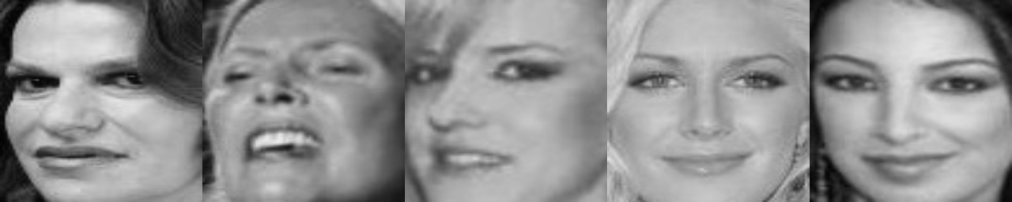
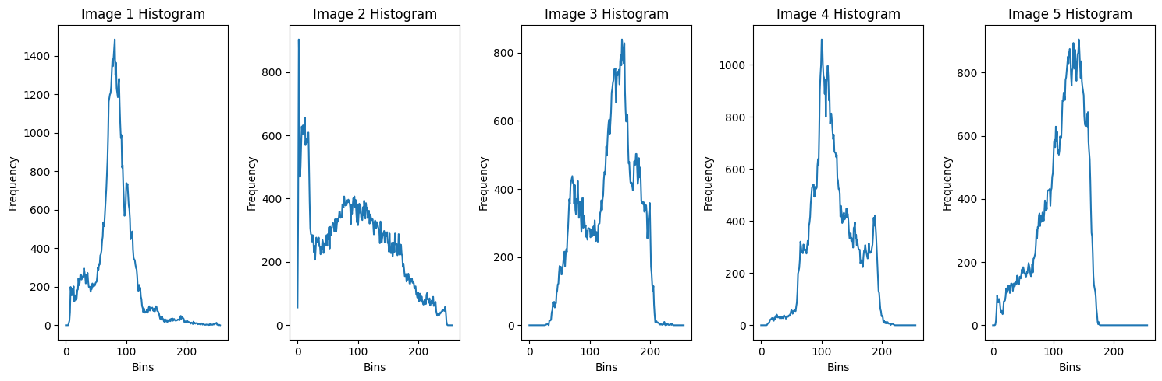
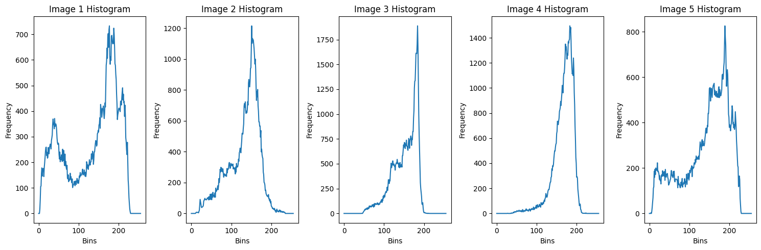
Gender Detection. (256,256)
Original Color Images
Original Gray Images
Histogram for gray images

Slide 4
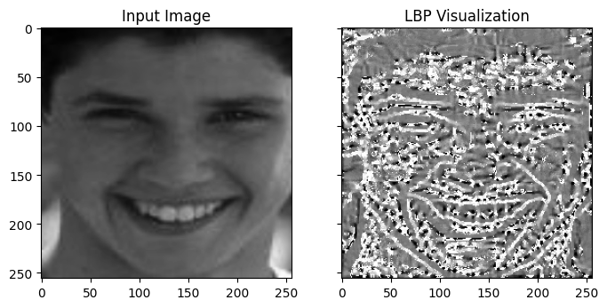
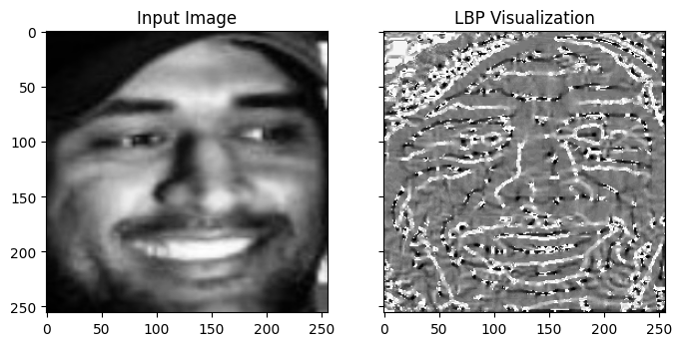
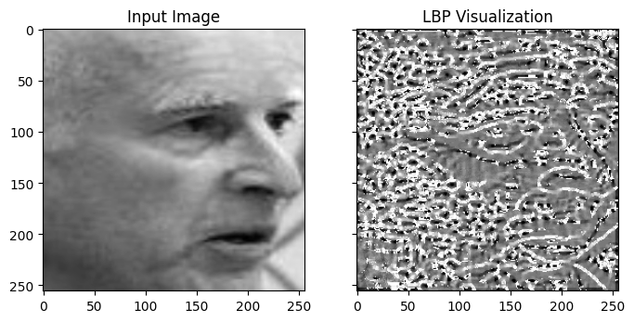
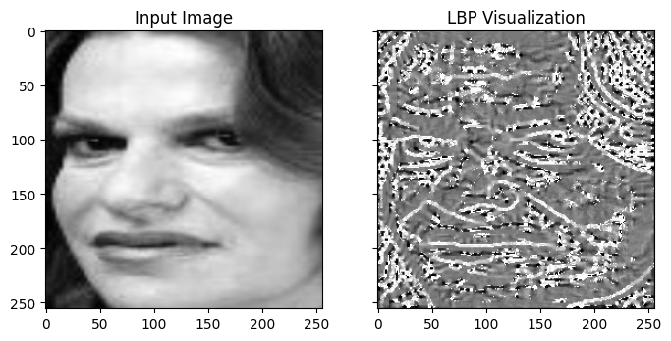
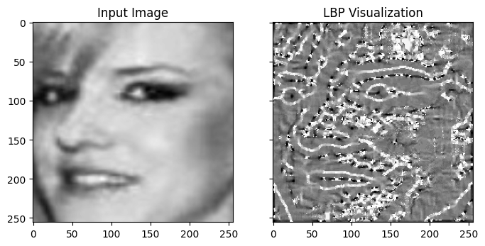
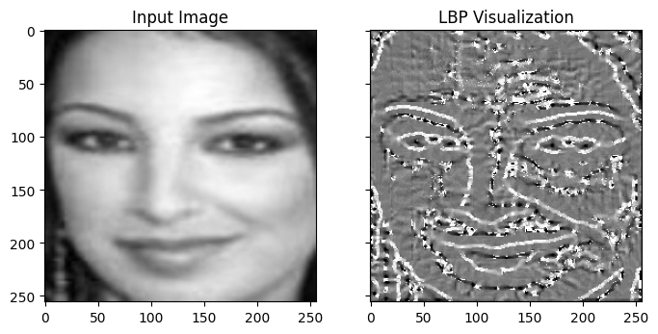
Features Extraction without filtering process
LBP
# Compute LBP features
radius = 3
n_points = 8 * radius
lbp = local_binary_pattern(image, n_points, radius, method='uniform')

Slide 5
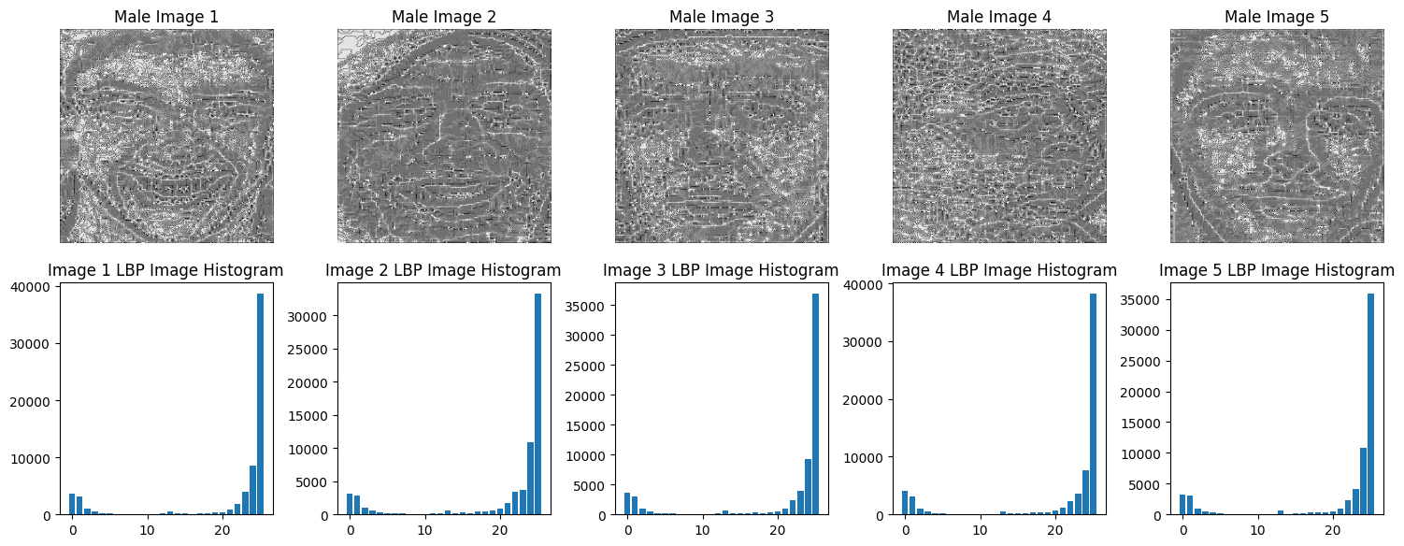
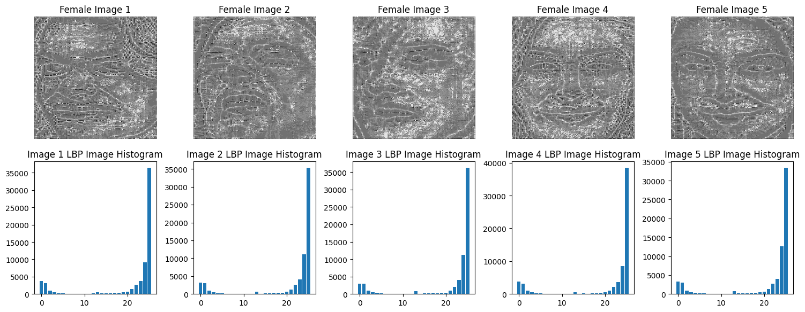

Slide 6
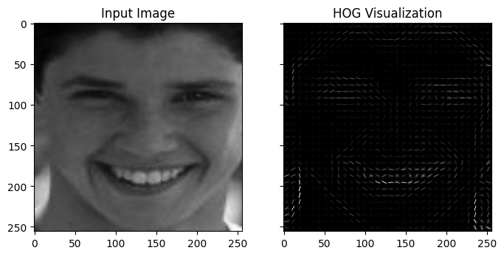
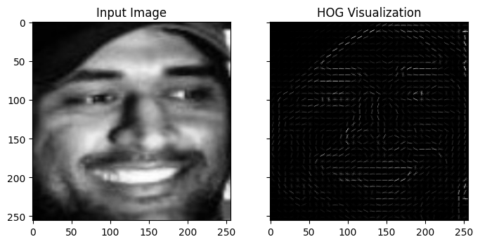
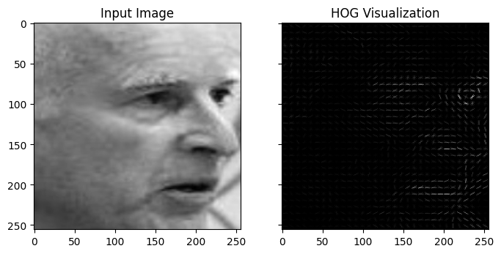
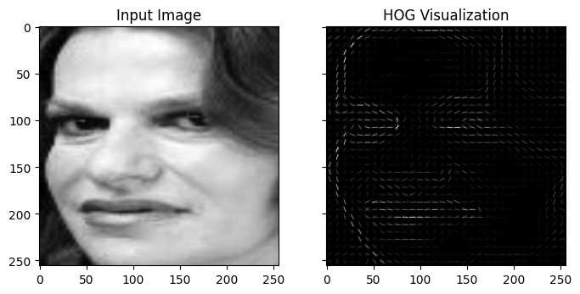
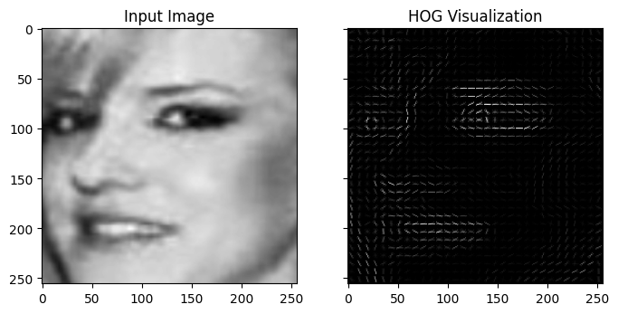
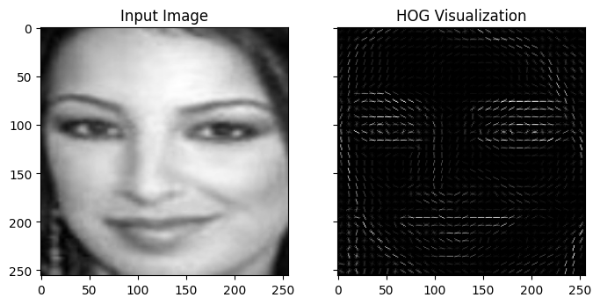
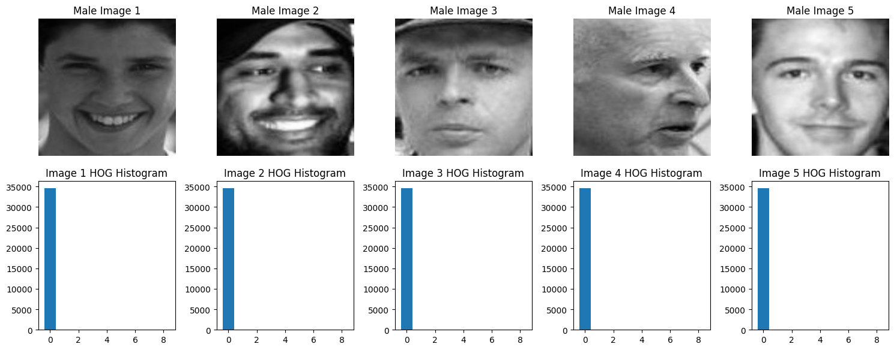
HOG Feature
hog_features, hog_image = hog(image, visualize=True, pixels_per_cell=(8, 8), cells_per_block=(2, 2))
Histogram does not have any interesting pattern so no histogram for this

Slide 7
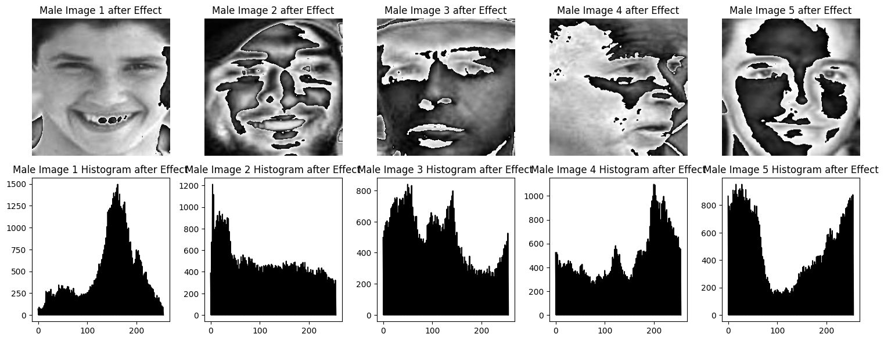
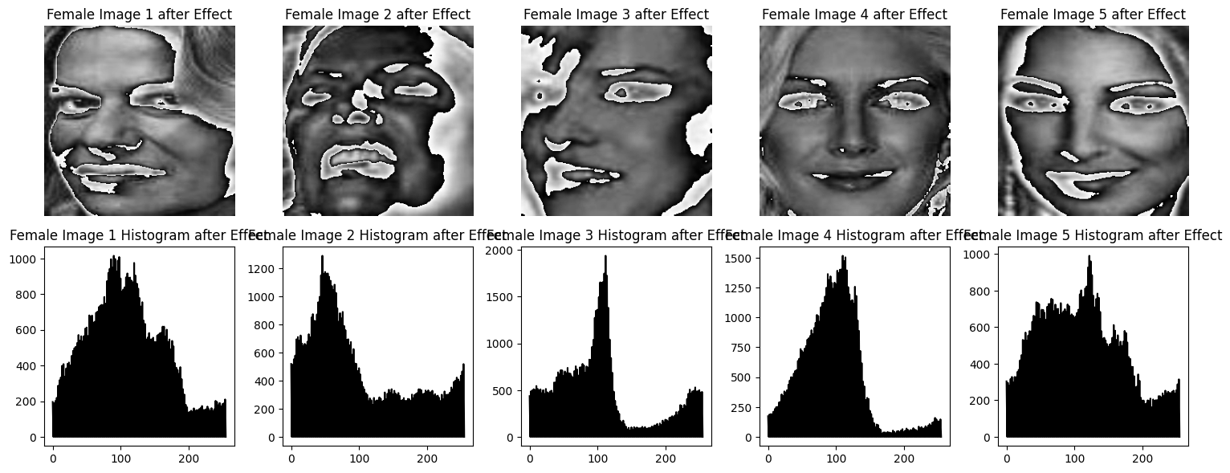
Pixel Intensity Feature

Slide 8
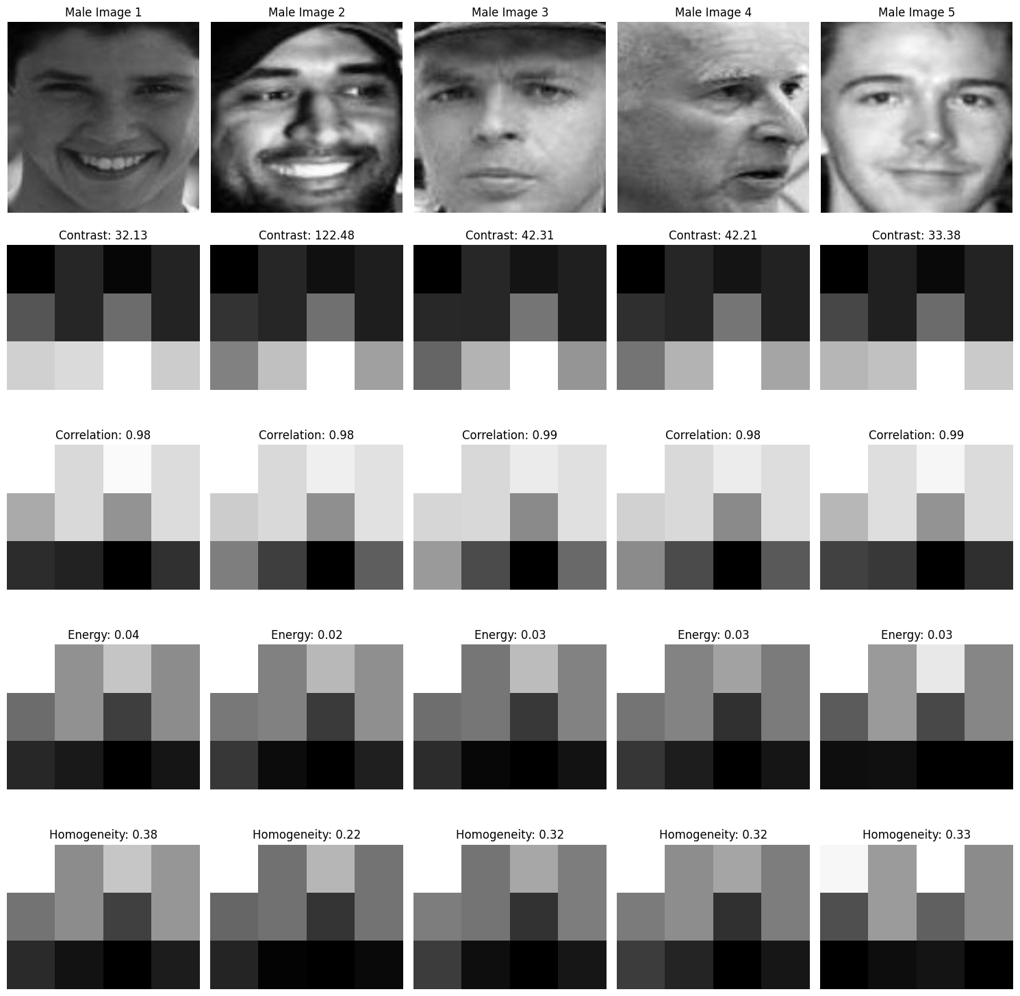
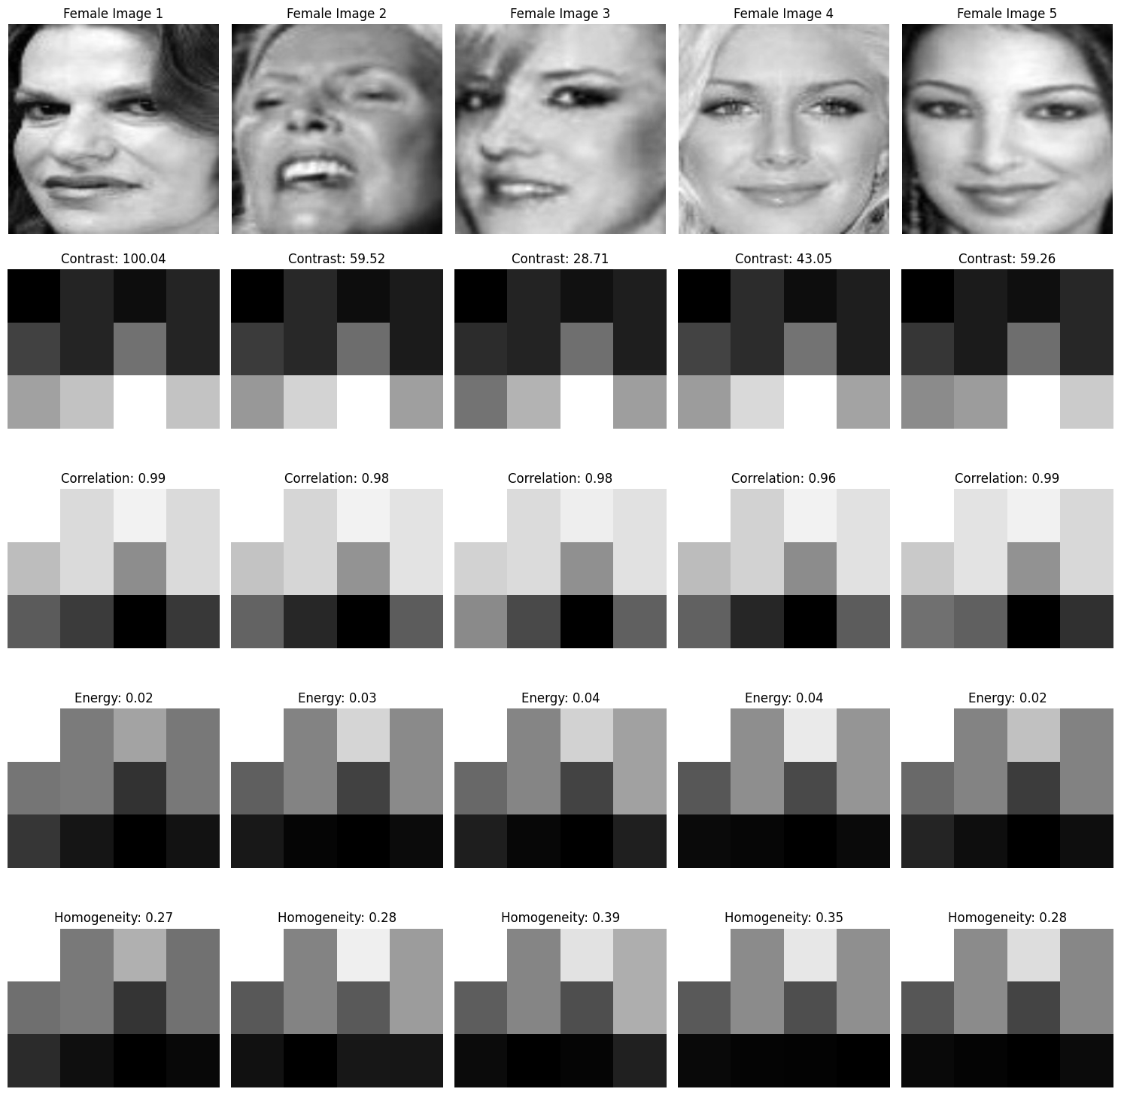
Haralick Feature
distances = [1, 2, 3] angles = [0, np.pi/4, np.pi/2, 3*np.pi/4] glcm = greycomatrix(image, distances=distances, angles=angles, symmetric=True, normed=True)
# Compute Haralick texture features
contrast = greycoprops(glcm, 'contrast')
correlation = greycoprops(glcm, 'correlation')
energy = greycoprops(glcm, 'energy')
homogeneity = greycoprops(glcm, 'homogeneity')

Slide 9
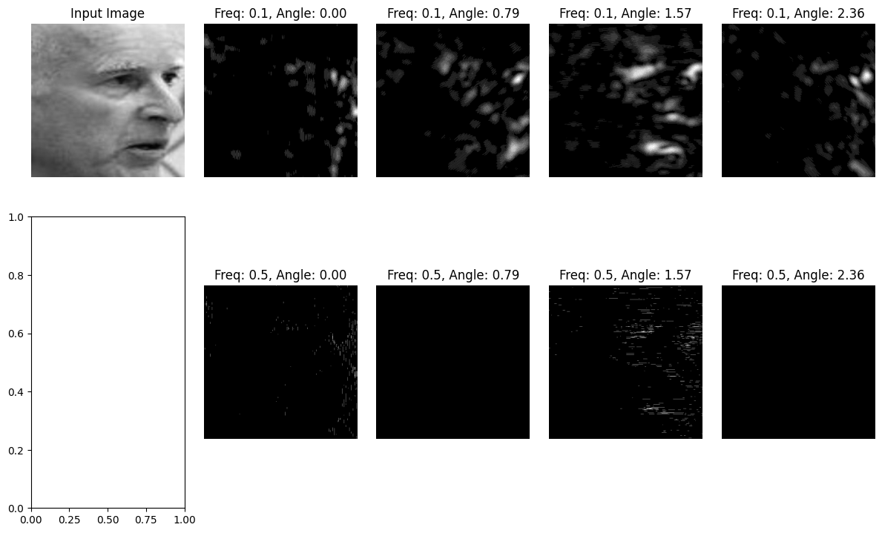
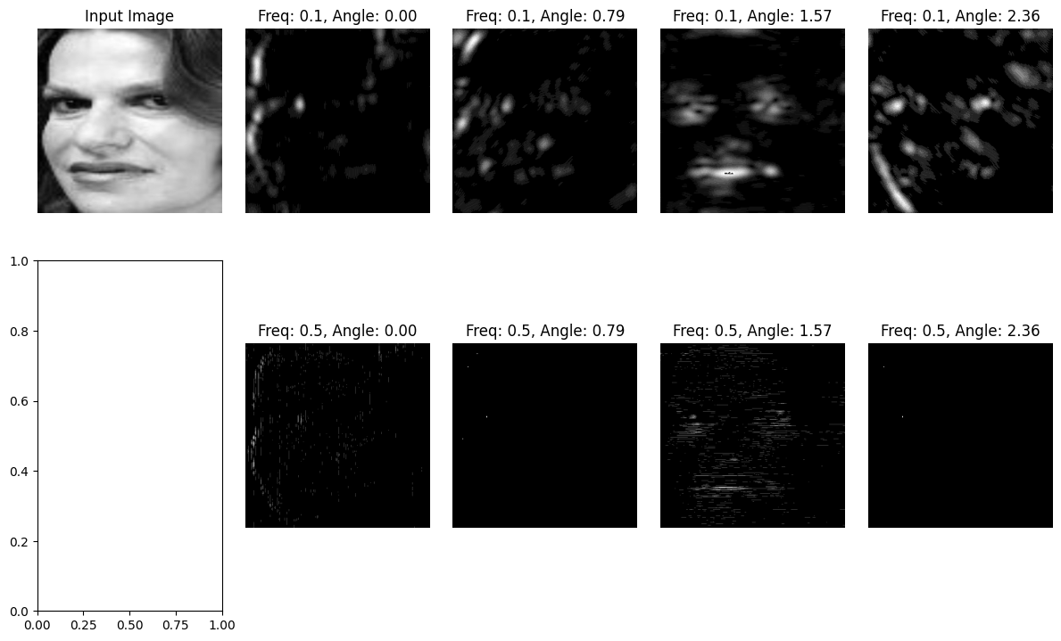
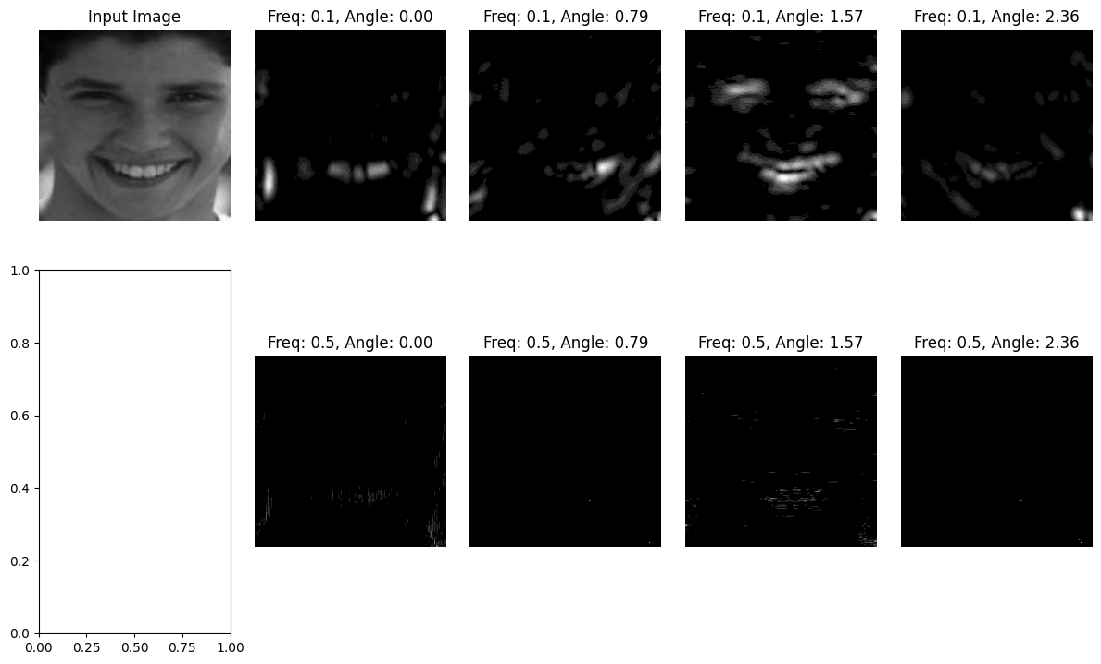
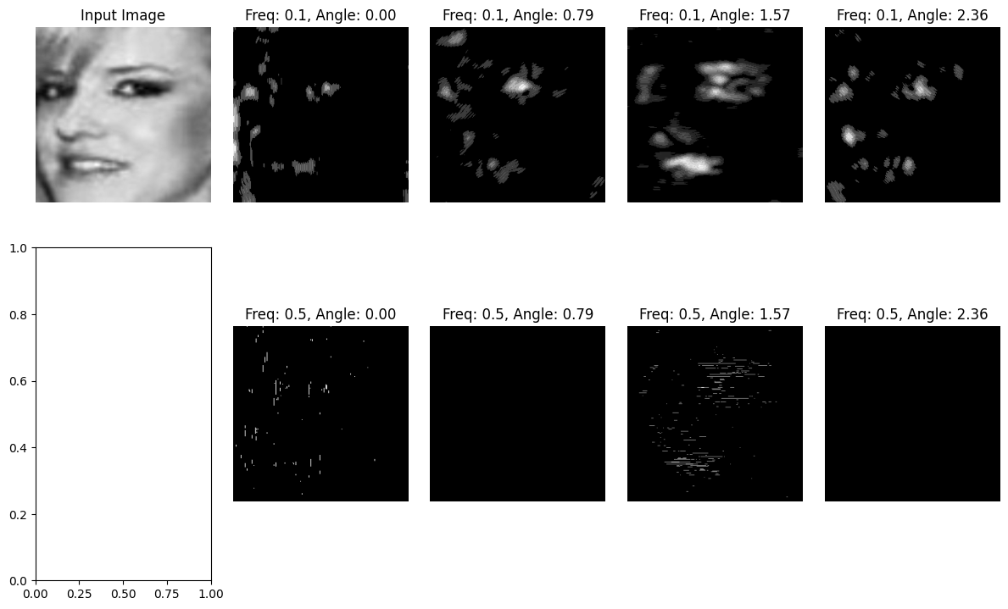
Gabor Feature
frequencies = [0.1, 0.5] # Adjust frequencies as needed
angles = [0, np.pi/4, np.pi/2, 3*np.pi/4] # Adjust angles as needed
fig, axes = plt.subplots(nrows=len(frequencies), ncols=len(angles) + 1, figsize=(12, 8))

Slide 10
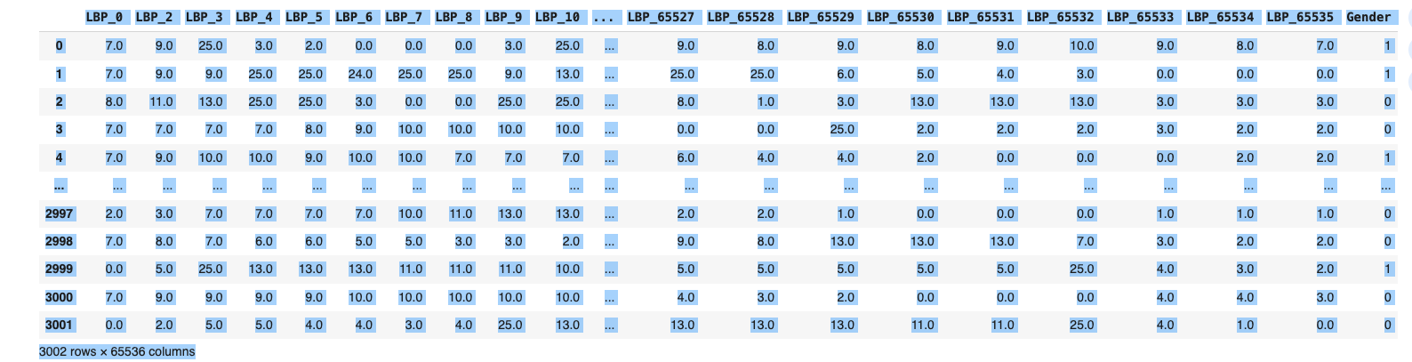
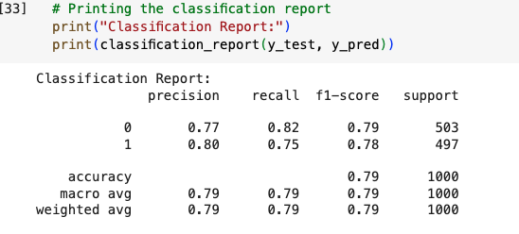
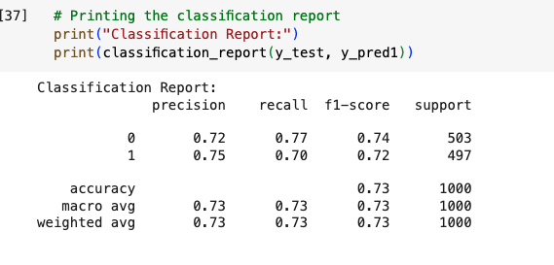
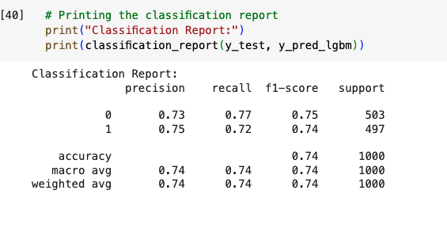
Test Result with LBP only(256,256)
I tried combing all the 5 features together but it was a complex job got errors many times so finally combined LBP and HOG only
Tried only with the LBP feature as it is one of the best features for image recognition
Shape of X: (3002, 65535) Shape of y: (3002,)
SVM. XGB LGBM

Slide 11
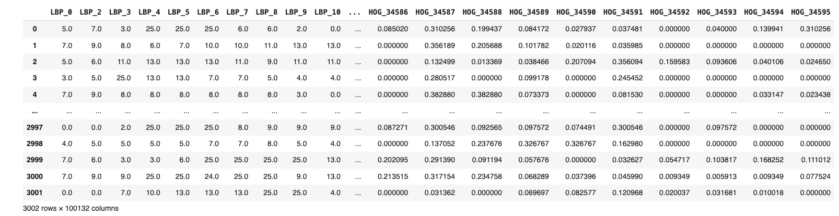
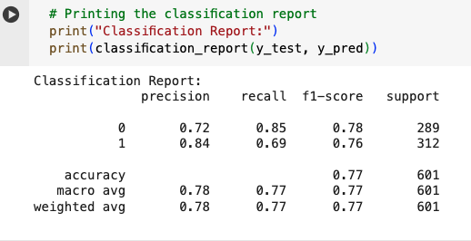
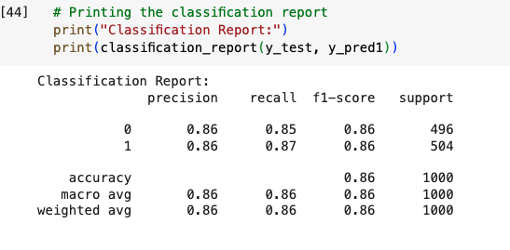
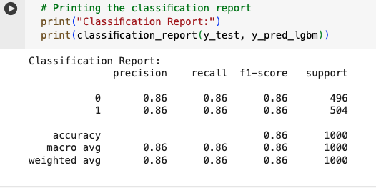
Combined Features LBP and HOG
Shape of X: (3002,100131)
Shape of y: (3002,)
SVC XGB LGBM

Slide 12




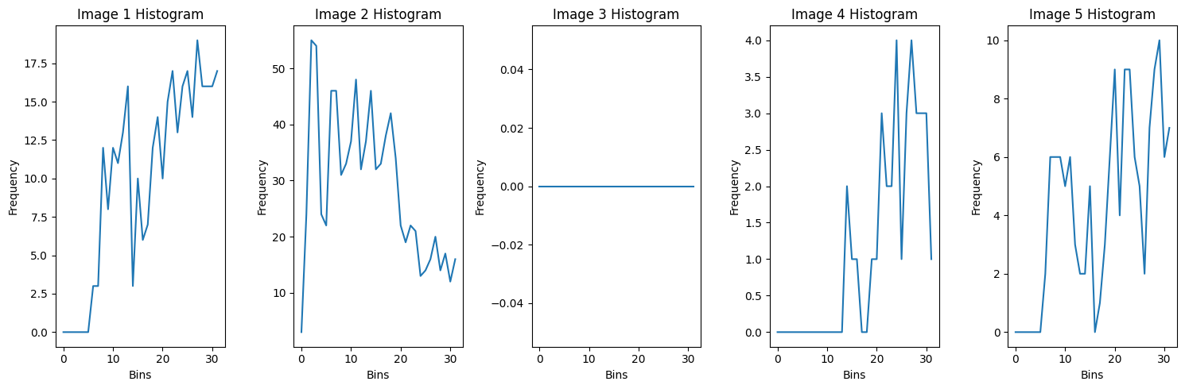
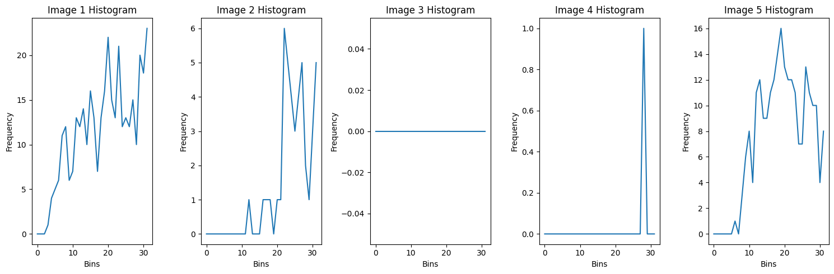
Original and gray images with histogram
Combined Features to make a Data Frame(64x64)
When pixel size reduced to 64, 64

Slide 13
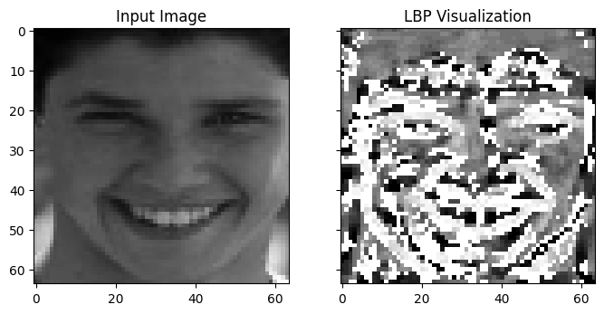
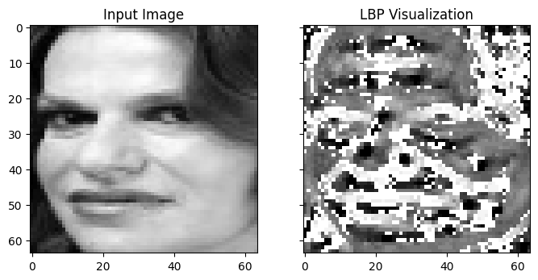
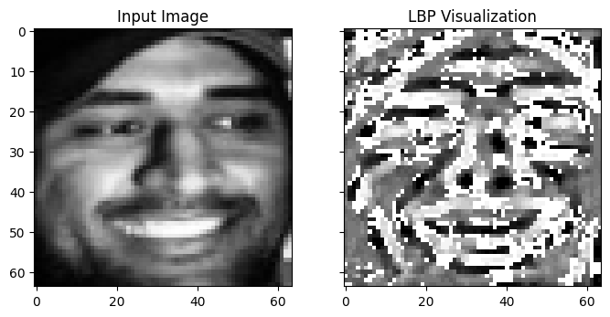
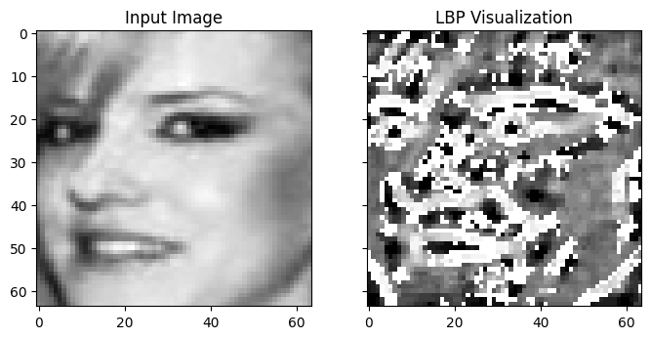
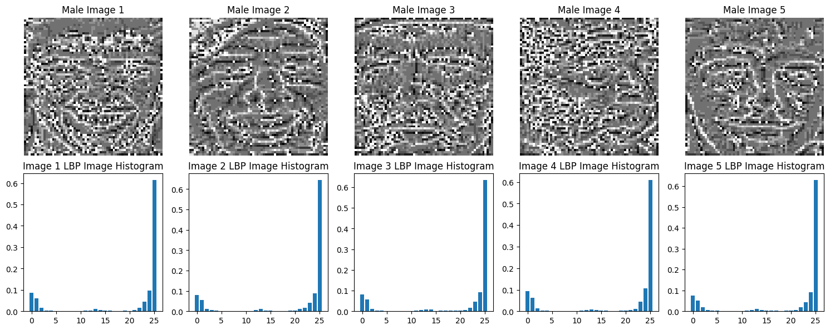
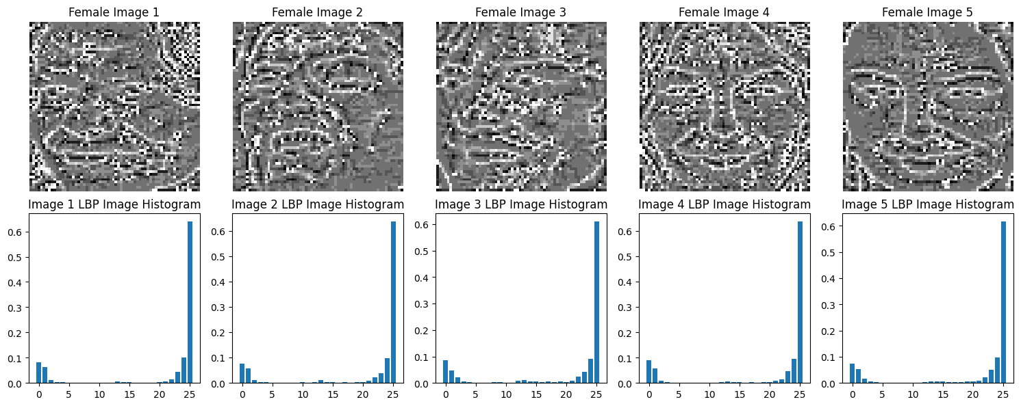
LBP Feature

Slide 14
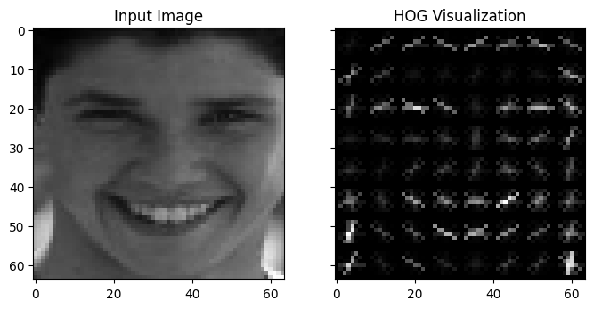
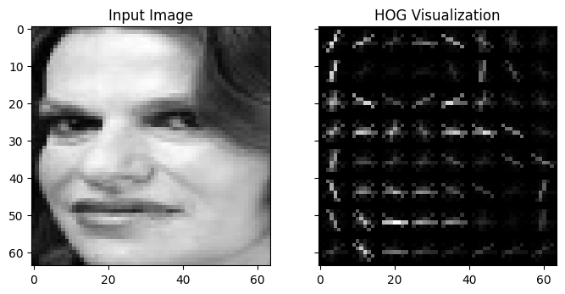
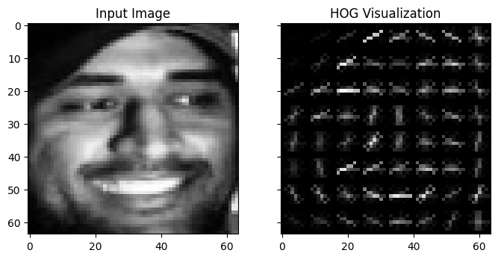
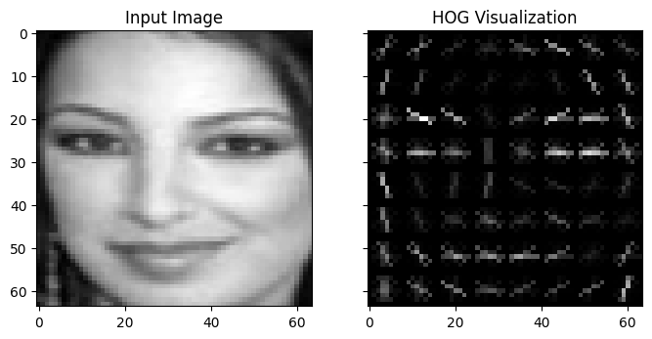
HOG Feature

Slide 15
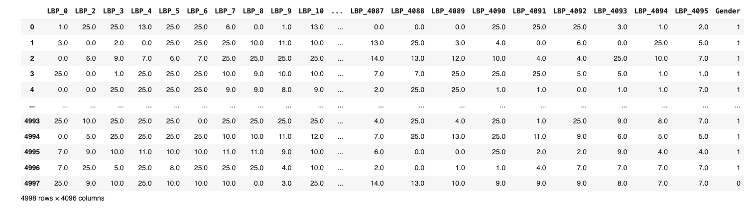
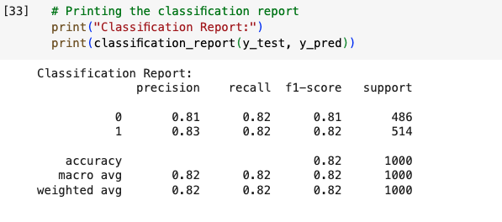
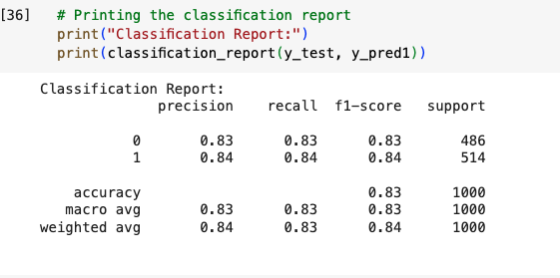
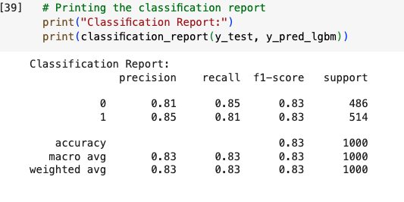
LBP ONLY (64x64)
SVC XGB LGBM

Slide 16





LBP and HOG dataset(64x64)
For (32,32)
SVM
XGBOOST
LGBM

Slide 17






Features Extraction with Enhanced and Sharpened Images
Percentile based min=5, max=93
After

Slide 18


Sobel Sharpening for Percentile based
Kernel=3x3
After

Slide 19








HOG Feature for Percentile based
LBP Feature for Percentile based

Slide 20




Model and Report for Percentile based
SVM XGB LGBM

Slide 21




Histogram based
After

Slide 22


Sobel Sharpening for Histogram based
After

Slide 23








Feature Extraction for Hist based
HOG
LBP

Slide 24




Modeling for Histogram Based
SVM XGB LGBM

Slide 25




Gamma based
After

Slide 26


Sobel Sharpening for Gamma based
After

Slide 27








Feature Extraction for Gamma Based
HOG
LBP

Slide 28




Modeling for Gamma Based
SVM XGB LGBM

Slide 29
Challenges and Overcomes:
For best work requires 100GB’s of RAM which is not possible for now and requires sponsors
Takes hours for processing a single feature extraction
Lengthy process and could give worse result for any simple mistakes
4. Less images less accuracy more images more accuracy
Use numbers of images reasonably as per device capacity
Try batch wise distribution for lengthy codes and features extraction
Reduce the size of pixels for fast work
Observe carefully to track the work step by step
Try best with less resources and consider for future implementation of project when resources available

